Slide 1
Vertebrate evolution Lab

Slide 2
What to do (in order):
Read the Vertebrate PPT for class
Watch videos listed in the remainder of this PPT
Answer the Vertebrate Lab report questions
Let's take a closer look not only at the vertebrate chordates…but the evolution of them as well!!!!!

Slide 3
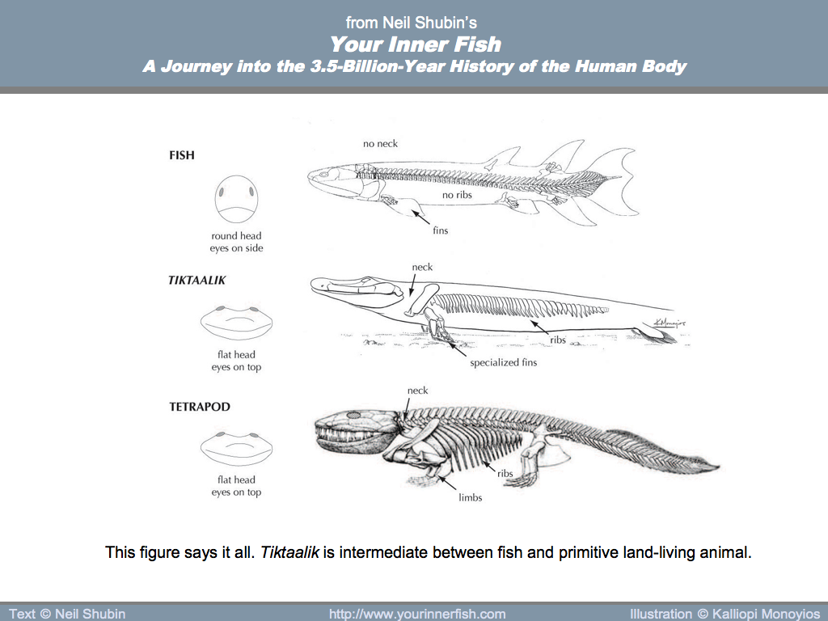
Tetrapod Evolution
Click and explore
Great transformations interactive:
https://media.hhmi.org/biointeractive/click/great-transitions/
Explore the interactive simulation
Finding Tiktaalik, the Fossil Link Between Fish and Land Animals
https://www.labxchange.org/library/items/lb:LabXchange:3a2408f2:video:1
Watch the video
Meet Tiktaalik
https://tiktaalik.uchicago.edu/
Interact with the website
Answer the questions in the lab report

Slide 4
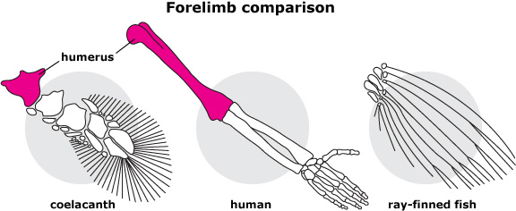
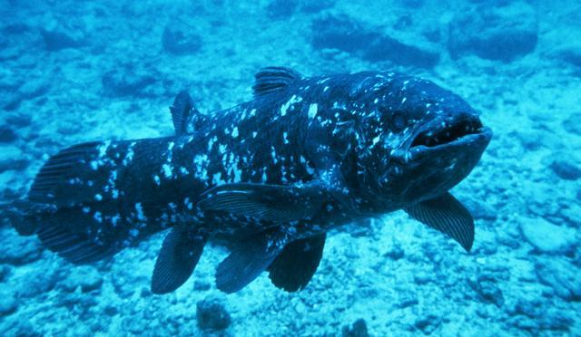
Ancient Fish and
Tetrapod anatomy
Explore the Coelocanth
Watch the videos:
https://www.youtube.com/watch?time_continue=6&v=HJ3yLh_CYg4&feature=emb_title
https://www.youtube.com/watch?v=ujKL1pUHDfo
Answer the questions in the lab report

Slide 5
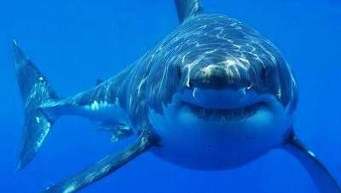
Fish
Watch the following videos on Fish:
https://www.youtube.com/watch?v=PoND3a-afJw
https://www.youtube.com/watch?v=5Tv2upM-x1U
https://www.youtube.com/watch?v=Cd-artSbpXc
--> Review the videos and answer the questions on the lab report handout

Slide 6
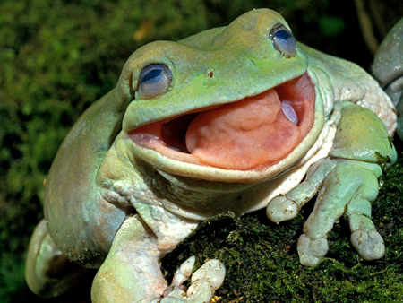
Amphibians
Watch the following videos on frog metamorphosis:
https://www.youtube.com/watch?v=h6yNOUhdOGQ
Watch the following video about amphibians:
https://www.youtube.com/watch?v=U2gz2ke8kik
Answer the questions in your lab report

Slide 7
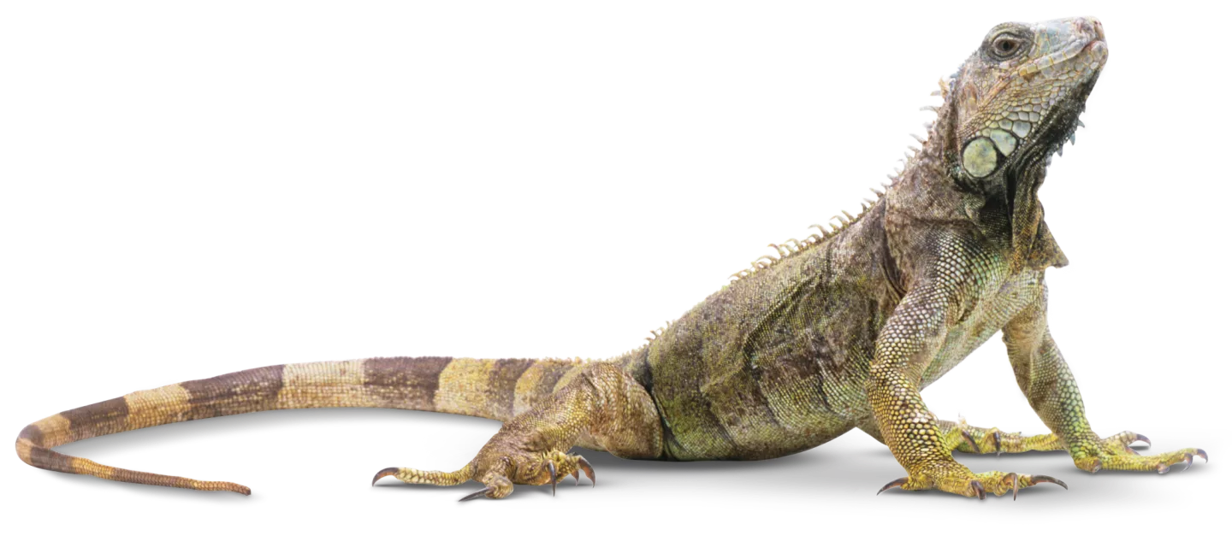
Reptiles
Watch the following videos on reptiles:
https://www.youtube.com/watch?v=oBz00-Go3qg
https://www.youtube.com/watch?v=4Ntfup1d_hM
--> Review the videos and answer the questions on the lab report handout

Slide 8
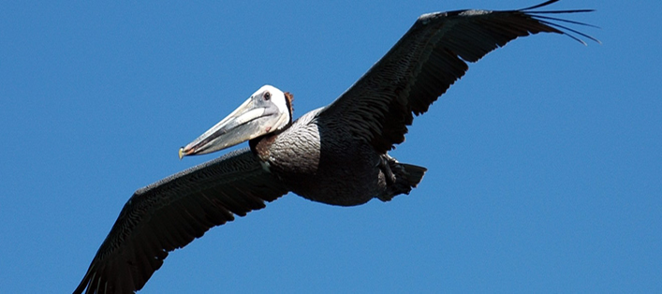
Birds
Watch the videos about... DinoBirds?
https://www.youtube.com/watch?v=0-7iXyYS0uw
https://www.youtube.com/watch?v=eaWb0UUNc00
Characteristics of Birds’ Video
https://www.youtube.com/watch?v=jGkP7IrDp_4
Answer the questions on the lab report handout

Slide 9
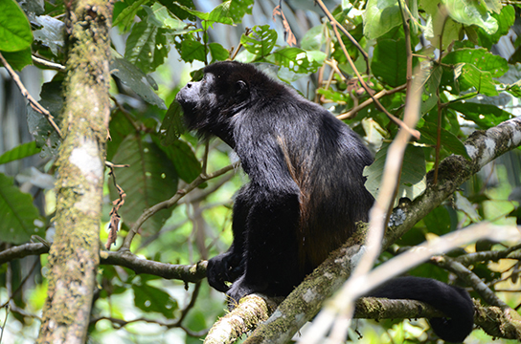
Mammals
Watch the videos about the basic characteristics of all mammals:
https://www.youtube.com/watch?v=mXs71vqrvqI
Groups of mammals (watch only up to 5 minutes, description of main groups):
https://www.youtube.com/watch?v=UPihrBlReXQ
Answer the questions on the lab report handout

